Slide 1
Dan Jurafsky and James Martin
Speech and Language Processing
Chapter 6
Vector Semantics, Part 3

Slide 2
Re-cap: Skip-Gram Training
Training sentence:
... lemon, a tablespoon of apricot jam a pinch ...
c1 c2 t c3 c4
For each positive example, we'll create k negative examples.
Using noise words
Any random word that t never occurred with

Slide 3
Re-cap: Skip-Gram Training
Training sentence:
... lemon, a tablespoon of apricot jam a pinch ...
c1 c2 t c3 c4
k=2
Notes:
Here k = 2, so we are picking twice as many negative training examples as positive ones.

Slide 4
Notes:
The skip-gram model tries to shift embeddings so the target embedding (here for apricot) are closer to (have a higher dot product with) context embeddings for nearby words (here jam) and further from (have a lower dot product with) context embeddings for words that don’t occur nearby (here aardvark).
Note that the skip-gram model thus actually learns two separate embeddings for each word w: the target embedding t and the context embedding c. These embeddings are stored in two matrices, the target matrix T and the context matrix C. So each row i of the target matrix T is the 1 × d vector embedding ti for word i in the vocabulary V , and each column i of the context matrix C is a d × 1 vector embedding ci for word i in V . This figure shows an intuition of the learning task for the embeddings encoded in these two matrices.

Slide 5
Recap: How to learn word2vec (skip-gram) embeddings
Start with V random 300-dimensional vectors as initial embeddings
Use logistic regression, the second most basic classifier used in machine learning after naïve Bayes
Take a corpus and take pairs of words that co-occur as positive examples
Take pairs of words that don't co-occur as negative examples
Train the classifier to distinguish these by slowly adjusting all the embeddings to improve the classifier performance
Throw away the classifier code and keep the embeddings.
Notes:
Logistic regression is covered in Chapter 5 of the textbook

Slide 6
Dependency-based word embeddings

Slide 7
Properties of embeddings
Similarity depends on window size C
C = ±2 The nearest words to Hogwarts:
Sunnydale
Evernight
C = ±5 The nearest words to Hogwarts:
Dumbledore
Malfoy
halfblood
Notes:
Sunnydale = Buffy the vampire slayer setting.
Evernight Academy = vampire-based romantic fantasy novels

Slide 8
How does context window change word emeddings?

Slide 9
Solving analogies with embeddings
In a word-analogy task we are given two pairs of words that share a relation (e.g. “man:woman”, “king:queen”).
The identity of the fourth word (“queen”) is hidden, and we need to infer it based on the other three by answering
“man is to woman as king is to — ?”
More generally, we will say a:a∗ as b:b∗.
Can we solve these with word vectors?

Slide 10
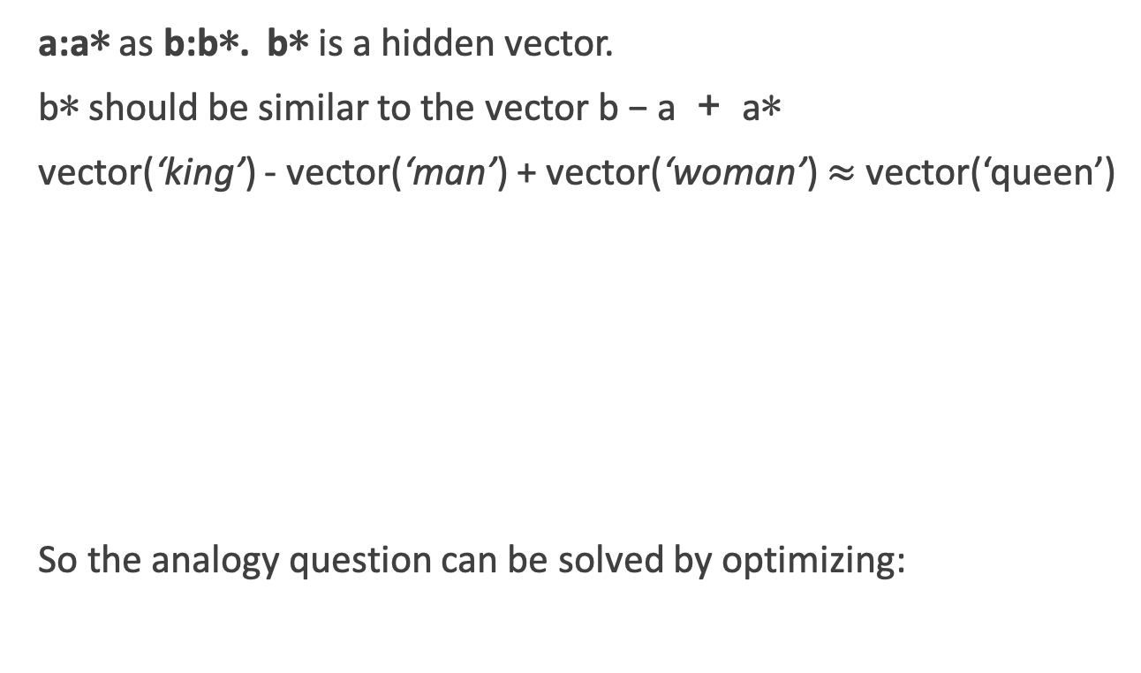
Vector Arithmetic
a:a∗ as b:b∗. b∗ is a hidden vector.
b∗ should be similar to the vector b − a + a∗
vector(‘king’) - vector(‘man’) + vector(‘woman’) $≈$vector(‘queen’)
So the analogy question can be solved by optimizing:
Notes:
where V is the vocabulary excluding the question words b, a and a∗, and sim is a similarity measure
Omery Levy and Yoav Goldberg define this as the 3COSADD method

Slide 11
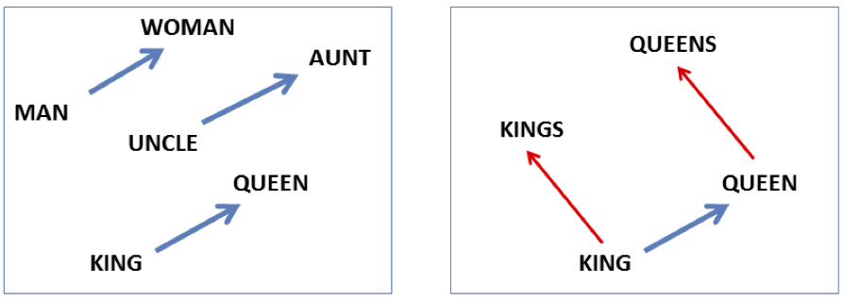
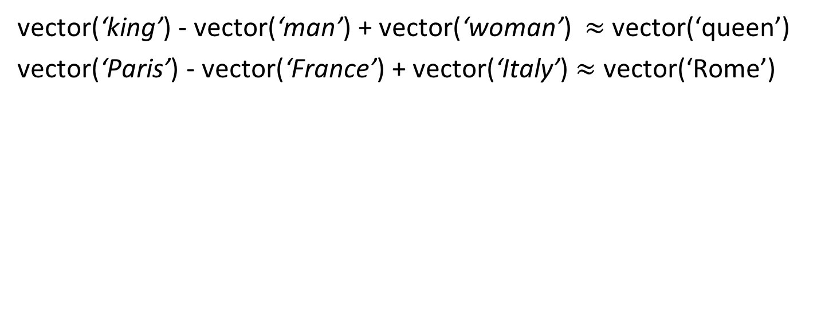
Analogy: Embeddings capture relational meaning!
vector(‘king’) - vector(‘man’) + vector(‘woman’) $≈$vector(‘queen’)
vector(‘Paris’) - vector(‘France’) + vector(‘Italy’) $≈$ vector(‘Rome’)
Notes:
Analogy Another semantic property of embeddings is their ability to capture relational meanings. Mikolov et al. (2013b) and Levy and Goldberg (2014b) show that the offsets between vector embeddings can capture some analogical relations between words. For example, the result of the expression vector(‘king’) - vec- tor(‘man’) + vector(‘woman’) is a vector close to vector(‘queen’); the left panel in Fig. 6.14 visualizes this, again projected down into 2 dimensions. Similarly, they found that the expression vector(‘Paris’) - vector(‘France’) + vector(‘Italy’) results in a vector that is very close to vector(‘Rome’).

Slide 12
Vector Arithmetic
If all word-vectors are normalized to unit length then
is equivalent to
Notes:
This means that solving analogy questions with vector arithmetic is mathematically equivalent to seeking a word (b∗) which is similar to b and a∗ but is different from a. Relational similarity is thus expressed as a sum of attributional similarities.
attributional similarities between vocabulary items means that words that appear in similar contexts will be close to each other in the projected space

Slide 13
Vector Arithmetic
Alternatively, we can require that the direction of the transformation be maintained.
This basically means that b∗ − b shares the same direction with a∗ − a, ignoring the distances
Notes:
Levy and Goldberg refer to this method as PAIRDIRECTION.
In this study, we show that similarly to the neural embedding space, the explicit vector space also encodes a vast amount of relational similar- ity which can be recovered in a similar fashion, suggesting the explicit vector space representation as a competitive baseline for further work on neu- ral embeddings

Slide 14
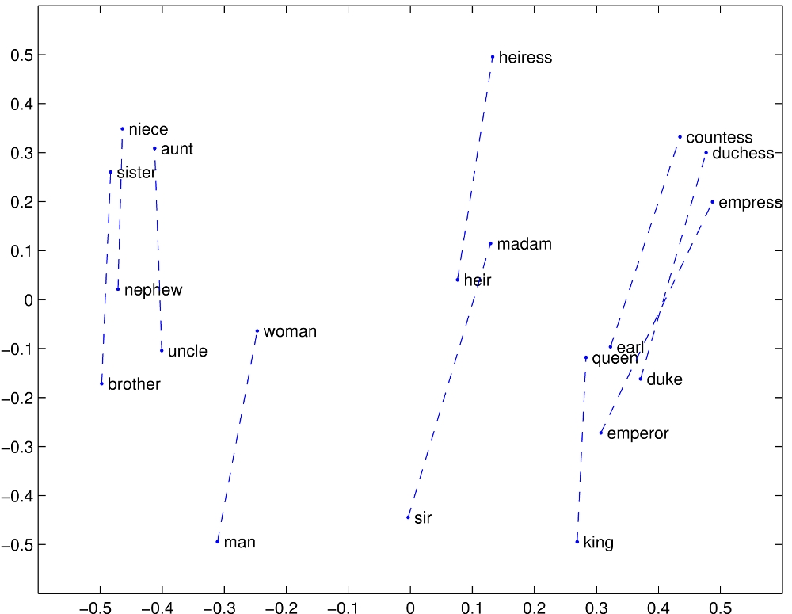
Notes:
Relational properties of the vector space, shown by projecting vectors onto two dimensions. (a) ’king’ - ’man’ + ’woman’ is close to ’queen’

Slide 15
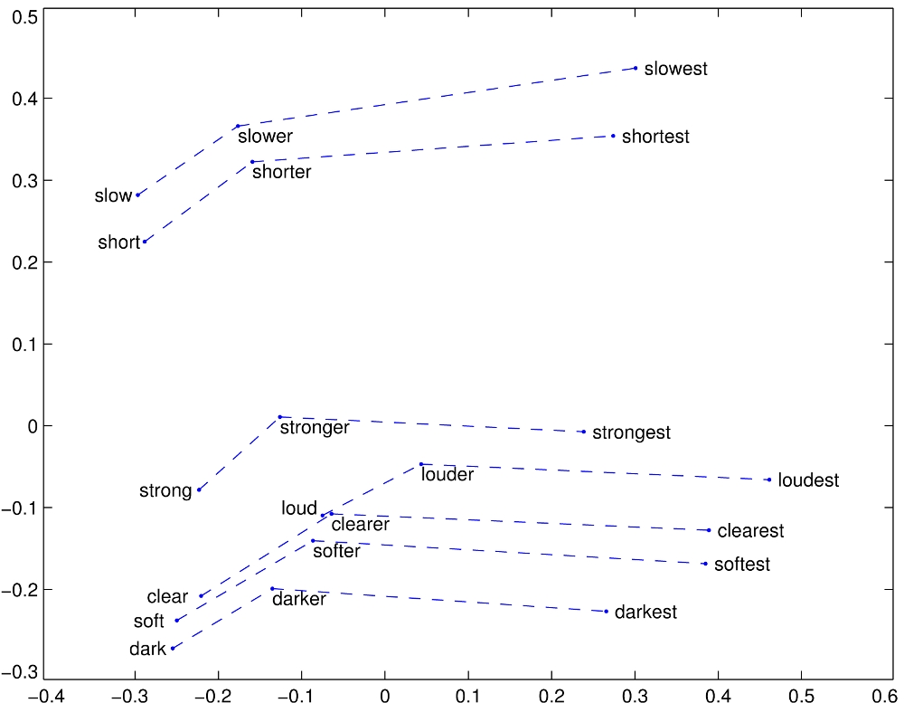
Notes:
Relational properties of the vector space,
offsets seem to capture comparative and superlative morphology (Pennington et al., 2014).

Slide 16
Representing Phrases with vectors
Mikolov et al constructed representations for phrases as well as for individual words.
To learn vector representations for phrases, they first find words that appear frequently together but infrequently in other contexts, and represent these n-grams as single tokens.
For example, “New York Times” and “Toronoto Maple Leafs” are replaced by New_York_Times and Toronoto_Maple_Leafs, but a bigram like “this is” remains unchanged.
Notes:
The δ is used as a discounting coefficient and prevents too many phrases consisting of very infre- quent words to be formed. The bigrams with score above the chosen threshold are then used as phrases. Typically, we run 2-4 passes over the training data with decreasing threshold value, allow- ing longer phrases that consists of several words to be formed.

Slide 17
Analogical reasoning task for phrases

Slide 18
Vector compositionality
Mikolov et al experiment with using element-wise addition to compose vectors
Notes:
CCB – try some out in Magnitude

Slide 19
Sneak peak at next EC assignment

Slide 20

Embeddings can help study word history!
Train embeddings on old books to study changes in word meaning!!
Dan Jurafsky
Will Hamilton
Notes:
Embeddings and Historical Semantics: Embeddings can also be a useful tool for studying how meaning changes over time, by computing multiple embedding spaces, each from texts written in a particular time period. For example Fig. 6.15 shows a visualization of changes in meaning in English words over the last two centuries, computed by building separate embedding spaces for each decade from historical corpora like Google N-grams (Lin et al., 2012) and the Corpus of Histori- cal American English (Davies, 2012).

Slide 21


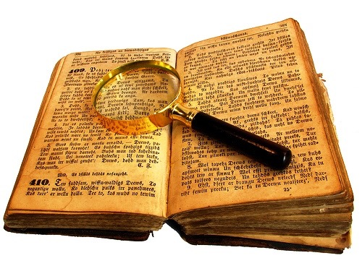
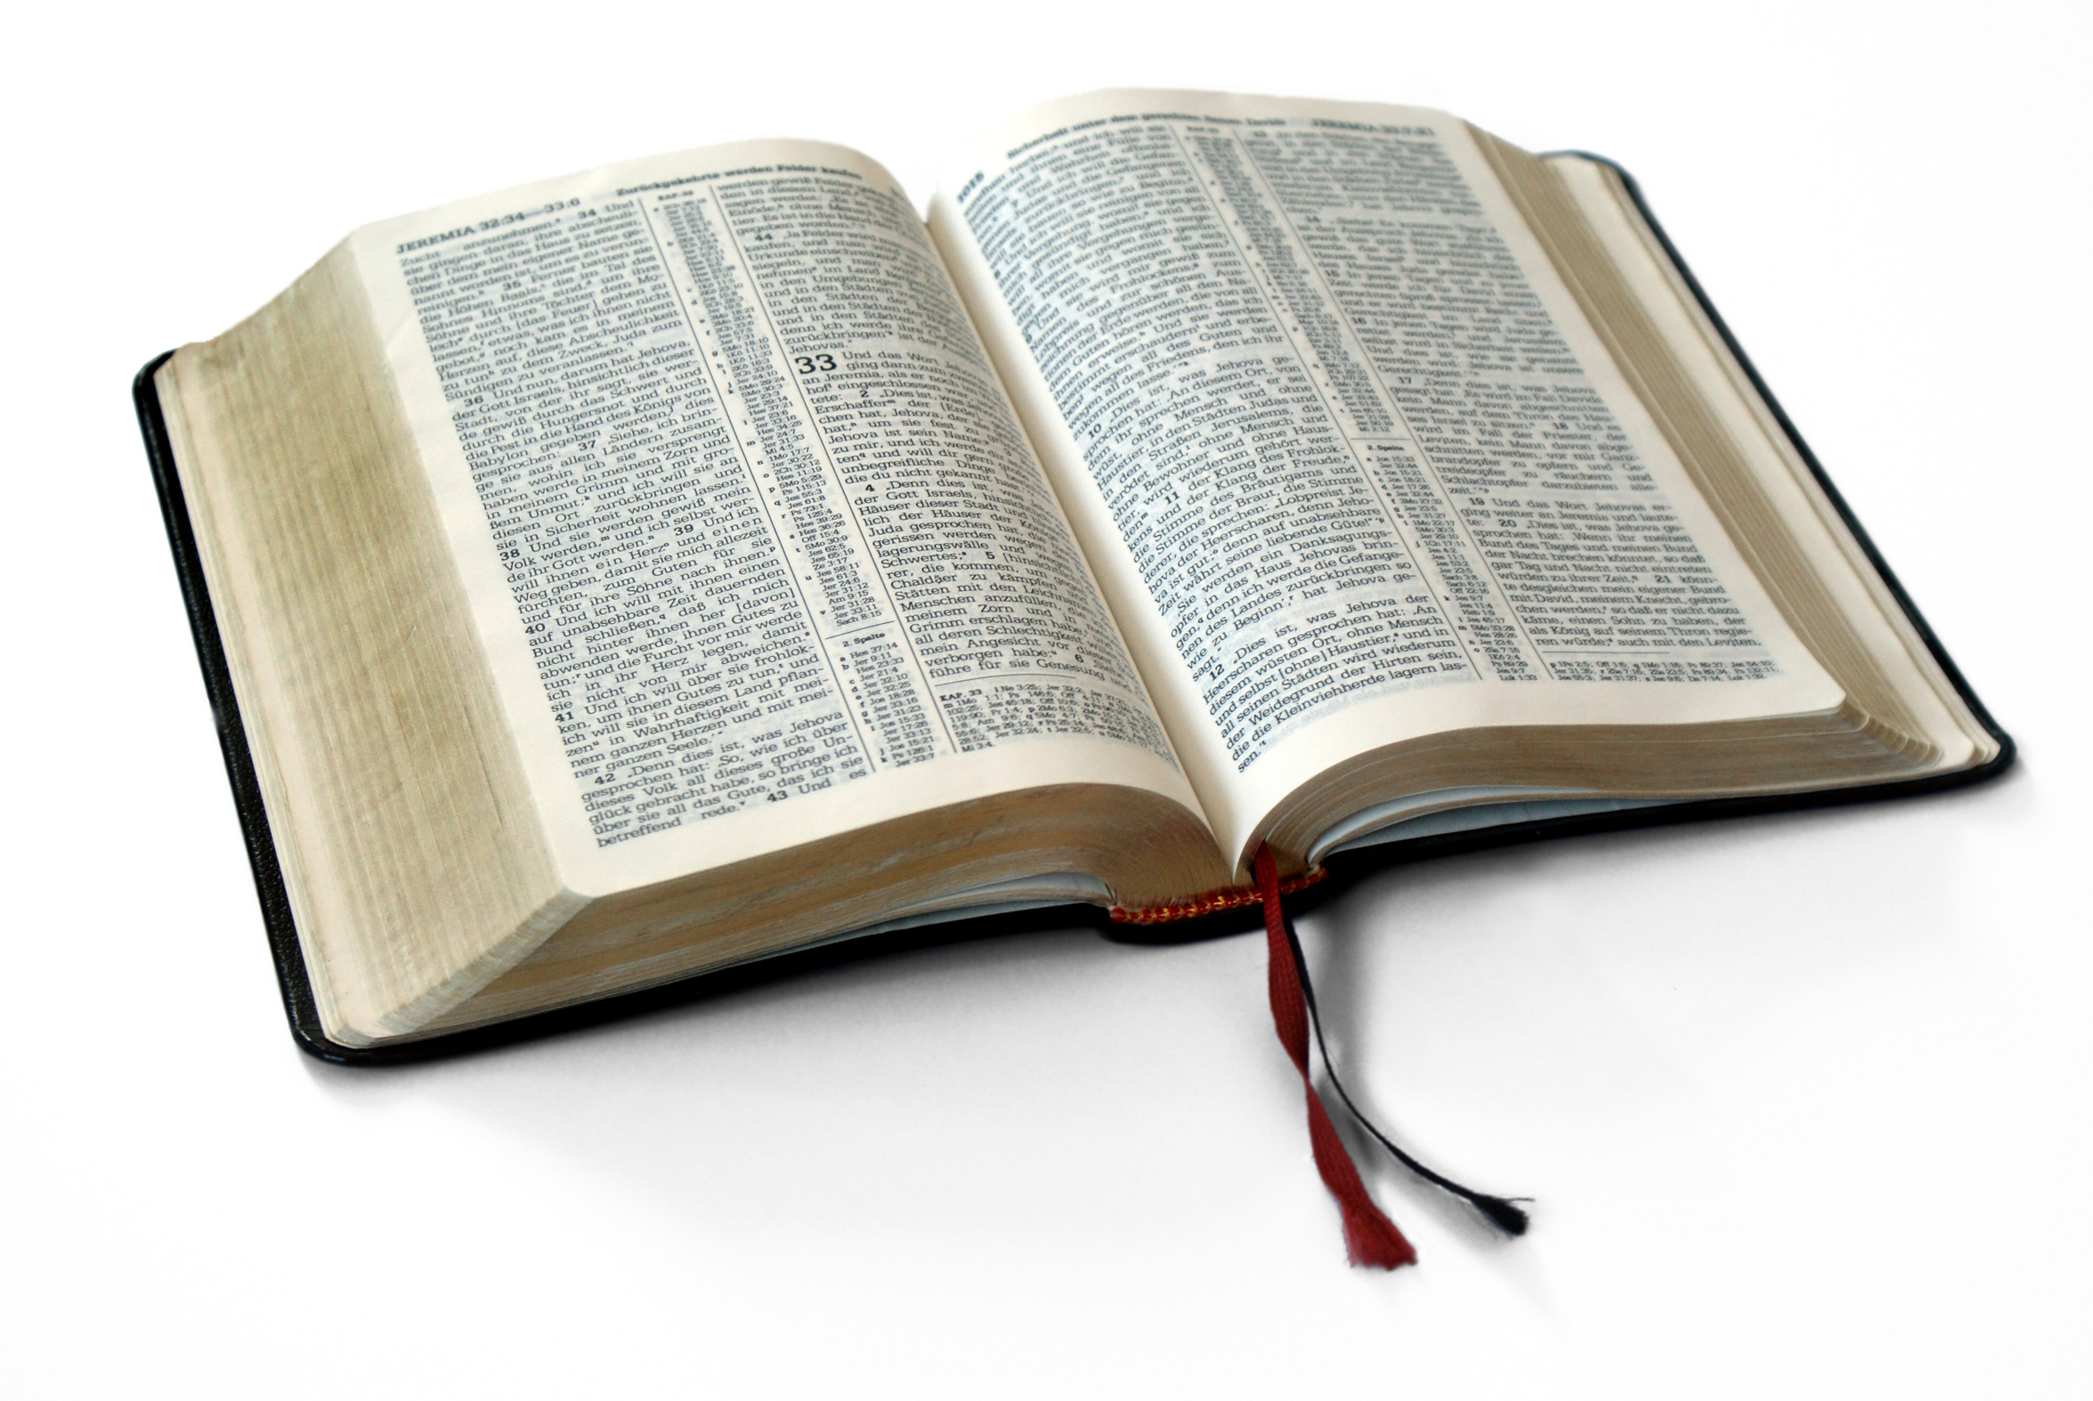
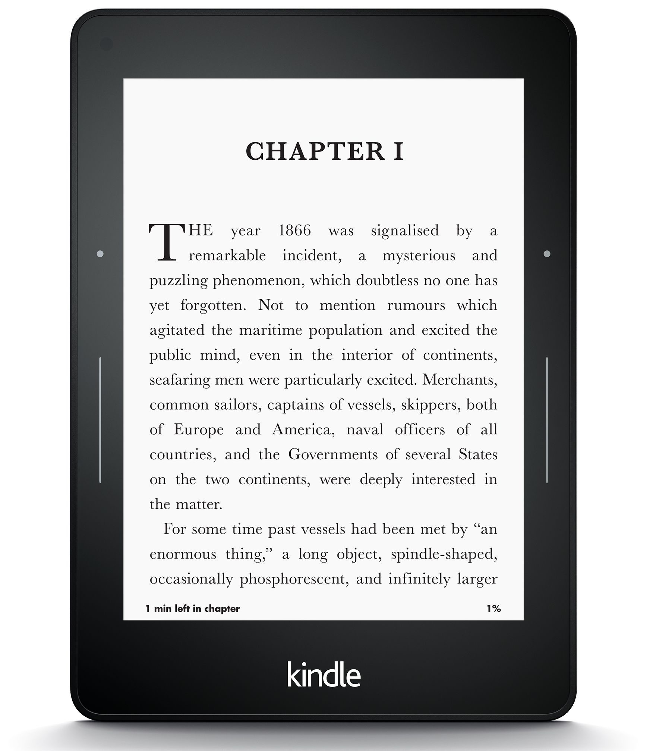
Diachronic word embeddings for studying language change!
Word vectors for 1920
Word vectors 1990
“dog” 1990 word vector
“dog” 1920 word vector
vs.
1900
1950
2000
￼
￼

Slide 22
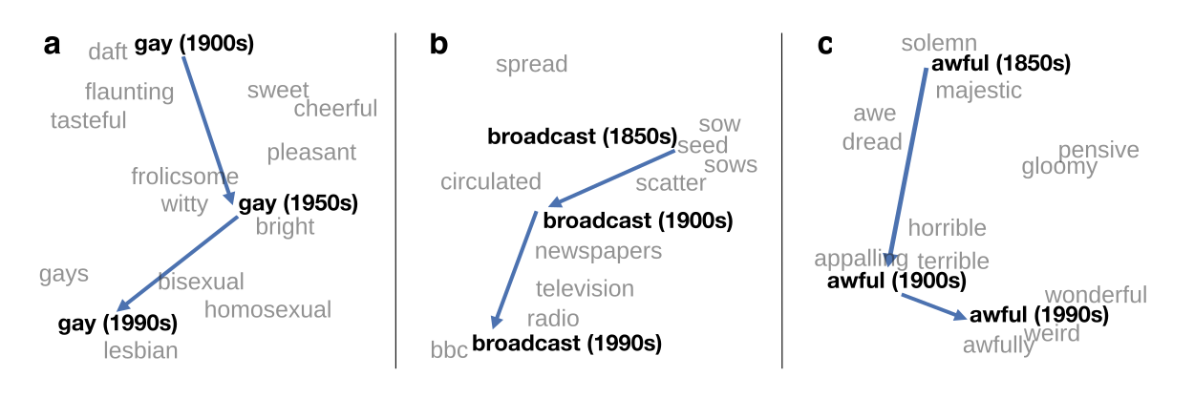
Visualizing changes
Project 300 dimensions down into 2
~30 million books, 1850-1990, Google Books data
Notes:
visualization of the semantic change of 3 words in English using
Figure 5à: Two-dimensional visualization of semantic change in English using SGNS word2vec vectors. The modern sense of each word, and the grey context words, are com-
vectors see Section 5à8 for the visualization algorithm à A, The word gay shifted puted from the most recent (modern) time-point embedding space. Earlier points are com-
from meaning ÒcheerfulÓ or ÒfrolicsomeÓ to referring to homosexualityà A, In the early puted from earlier historical embedding spaces. The visualizations show the changes in the
2àth century broadcast referred to Òcasting out seedsÓà with the rise of television and word gay from meanings related to “cheerful” or “frolicsome” to referring to homosexuality,
radio its meaning shifted to Òtransmitting signalsÓà C, Awful underwent a process of the development of the modern “transmission” sense of broadcast from its original sense of
pejoration, as it shifted from meaning Òfull of aweÓ to meaning Òterrible or appallingÓ
sowing seeds, and the pejoration of the word awful as it shifted from meaning “full of awe” t2om2eàaning “terrible or appalling”

Slide 23
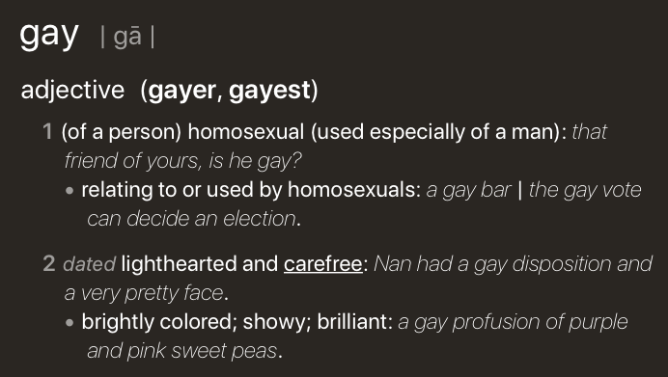
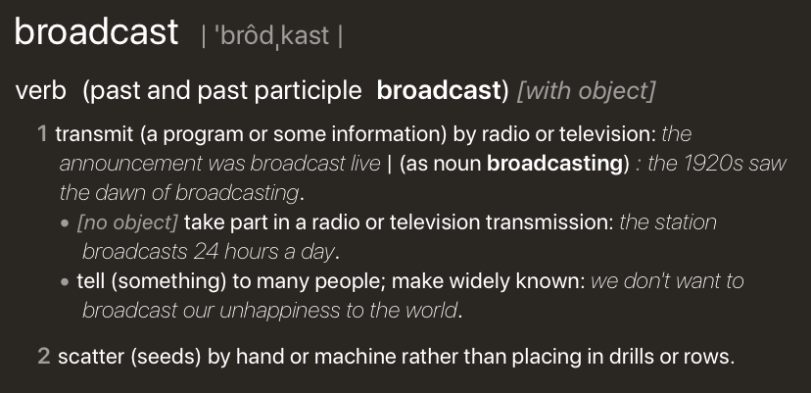
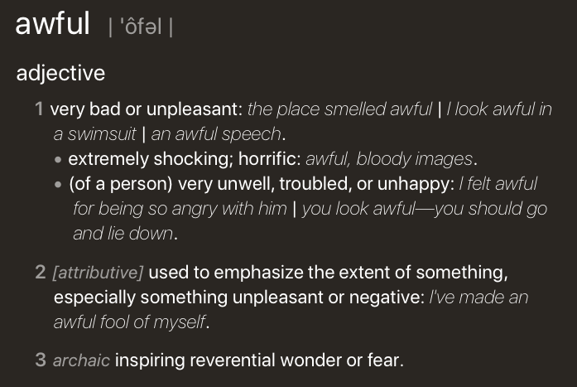
Visualizing changes
Project 300 dimensions down into 2
~30 million books, 1850-1990, Google Books data
Notes:
visualization of the semantic change of 3 words in English using
Figure 5à: Two-dimensional visualization of semantic change in English using SGNS word2vec vectors. The modern sense of each word, and the grey context words, are com-
vectors see Section 5à8 for the visualization algorithm à A, The word gay shifted puted from the most recent (modern) time-point embedding space. Earlier points are com-
from meaning ÒcheerfulÓ or ÒfrolicsomeÓ to referring to homosexualityà A, In the early puted from earlier historical embedding spaces. The visualizations show the changes in the
2àth century broadcast referred to Òcasting out seedsÓà with the rise of television and word gay from meanings related to “cheerful” or “frolicsome” to referring to homosexuality,
radio its meaning shifted to Òtransmitting signalsÓà C, Awful underwent a process of the development of the modern “transmission” sense of broadcast from its original sense of
pejoration, as it shifted from meaning Òfull of aweÓ to meaning Òterrible or appallingÓ
sowing seeds, and the pejoration of the word awful as it shifted from meaning “full of awe” t2om2eàaning “terrible or appalling”

Slide 24
Embeddings and bias
Notes:
In addition to their ability to learn word meaning from text, embeddings, alas, also
indicating surprise disbelief à
reproduce the implicit biases and stereotypes that were latent in the text. Recall that
embeddings model analogical relations; ‘queen’ as the closest word to ’king’ - ’man’
+ ’woman’ implies the analogy man:woman::king:queen. But embedding analogies 5à2à2 Computational linguistic studies
also exhibit gender stereotypes.

Slide 25
Embeddings reflect cultural bias
Bolukbasi, Tolga, Kai-Wei Chang, James Y. Zou, Venkatesh Saligrama, and Adam T. Kalai. "Man is to computer programmer as woman is to homemaker? debiasing word embeddings." In Advances in Neural Information Processing Systems, pp. 4349-4357. 2016.
Ask “Paris : France :: Tokyo : x”
x = Japan
Ask “father : doctor :: mother : x”
x = nurse
Ask “man : computer programmer :: woman : x”
x = homemaker
Notes:
For example Bolukbasi et al. (2016) find that the closest occupation to ‘man’ - ‘computer programmer’ + ‘woman’ in word2vec em-
There are also a number of recent works analyzing semantic change using computational
beddings trained on news text is ‘homemaker’, and that the embeddings similarly
methodsà 2àà use latent semantic analysis to analyze how word meanings broaden
suggest the analogy ‘father’ is to ‘doctor’ as ‘mother’ is to ‘nurse’. Algorithms that
and narrow over timeà 3 use raw co-occurrence vectors to perform a number of
used embeddings as part of an algorithm to search for potential programmers or
historical case-studies on semantic change, and 252 perform a similar set of small-
doctors might thus incorrectly downweight documents with women’s names.

Slide 26
Measuring cultural bias
Implicit Association test (Greenwald et al 1998): How associated are
concepts (flowers, insects) & attributes (pleasantness, unpleasantness)?
Studied by measuring timing latencies for categorization.
Psychological findings on US participants:
African-American names are associated with unpleasant words (more than European-American names)
Male names associated more with math, female names with arts
Old people's names with unpleasant words, young people with pleasant words.
Notes:
Roughly speaking, if humans associate ‘flowers’ with ’pleasantness’ and ‘insects’ with ‘unpleasant- ness’, when they are instructed to push a red button for ‘flowers’ (daisy, iris, lilac) and ’pleasant words’ (love, laughter, pleasure) and a green button for ‘insects’ (flea, spider, mosquito) and ‘unpleasant words’ (abuse, hatred, ugly) they are faster than in an incongruous condition where they push a red button for ‘flowers’ and ‘unpleasant words’ and a green button for ‘insects’ and ‘pleasant words
Embeddings also encode the implicit associations that are a property of human
scale case-studies using temporal topic modelsà 8à construct point-wise mutual
reasoning. The Implicit Association Test (Greenwald et al., 1998) measures peo- information-based embeddings and found that semantic changes uncovered by their
ple’s associations between concepts (like ’flowers’ or ’insects’) and attributes (like
method had reasonable agreement with human judgmentsà 29 and 9 use ÒneuralÓ
‘pleasantness’ and ‘unpleasantness’) by measuring differences in the latency with
word-embedding methods to detect linguistic change pointsà Finally, 25à analyze
which they label words in the various categories.6 Using such methods, people in the United States have been shown to associate African-American names with
historical co-occurrences to test whether synonyms tend to change in similar waysà
unpleasant words (more than European-American names), male names more with mathematics and female names with the arts, and old people’s names with unpleas- ant words (Greenwald et al. 1998, Nosek et al. 2002a, Nosek et al. 2002b). Caliskan et al. (2017) replicated all these findings of implicit associations using GloVe vec- tors and cosine similarity instead of human latencies. For example Afrian American names like ‘Leroy’ and ‘Shaniqua’ had a higher GloVe cosine with unpleasant words while European American names (‘Brad’, ‘Greg’, ‘Courtney’) had a higher cosine with pleasant words. Any embedding-aware algorithm that made use of word senti- ment could thus lead to bias against African Americans.

Slide 27
Embeddings reflect cultural bias
Aylin Caliskan, Joanna J. Bruson and Arvind Narayanan. 2017. Semantics derived automatically from language corpora contain human-like biases. Science 356:6334, 183-186.
Caliskan et al. replication with embeddings:
African-American names (Leroy, Shaniqua) had a higher GloVe cosine with unpleasant words (abuse, stink, ugly)
European American names (Brad, Greg, Courtney) had a higher cosine with pleasant words (love, peace, miracle)
Embeddings reflect and replicate all sorts of pernicious biases.
Notes:
Roughly speaking, if humans associate ‘flowers’ with ’pleasantness’ and ‘insects’ with ‘unpleasant- ness’, when they are instructed to push a red button for ‘flowers’ (daisy, iris, lilac) and ’pleasant words’ (love, laughter, pleasure) and a green button for ‘insects’ (flea, spider, mosquito) and ‘unpleasant words’ (abuse, hatred, ugly) they are faster than in an incongruous condition where they push a red button for ‘flowers’ and ‘unpleasant words’ and a green button for ‘insects’ and ‘pleasant words
Embeddings also encode the implicit associations that are a property of human
scale case-studies using temporal topic modelsà 8à construct point-wise mutual
reasoning. The Implicit Association Test (Greenwald et al., 1998) measures peo- information-based embeddings and found that semantic changes uncovered by their
ple’s associations between concepts (like ’flowers’ or ’insects’) and attributes (like
method had reasonable agreement with human judgmentsà 29 and 9 use ÒneuralÓ
‘pleasantness’ and ‘unpleasantness’) by measuring differences in the latency with
word-embedding methods to detect linguistic change pointsà Finally, 25à analyze
which they label words in the various categories.6 Using such methods, people in the United States have been shown to associate African-American names with
historical co-occurrences to test whether synonyms tend to change in similar waysà
unpleasant words (more than European-American names), male names more with mathematics and female names with the arts, and old people’s names with unpleas- ant words (Greenwald et al. 1998, Nosek et al. 2002a, Nosek et al. 2002b). Caliskan et al. (2017) replicated all these findings of implicit associations using GloVe vec- tors and cosine similarity instead of human latencies. For example Afrian American names like ‘Leroy’ and ‘Shaniqua’ had a higher GloVe cosine with unpleasant words while European American names (‘Brad’, ‘Greg’, ‘Courtney’) had a higher cosine with pleasant words. Any embedding-aware algorithm that made use of word senti- ment could thus lead to bias against African Americans.

Slide 28
Directions
Debiasing algorithms for embeddings
Bolukbasi, Tolga, Chang, Kai-Wei, Zou, James Y., Saligrama, Venkatesh, and Kalai, Adam T. (2016). Man is to computer programmer as woman is to homemaker? debiasing word embeddings. In Advances in Neural Infor- mation Processing Systems, pp. 4349–4357.
Use embeddings as a historical tool to study bias

Slide 29
Embeddings as a window onto history
Nikhil Garg, Londa Schiebinger, Dan Jurafsky, and James Zou, (2018). Word embeddings quantify 100 years of gender and ethnic stereotypes. Proceedings of the National Academy of Sciences, 115(16), E3635–E3644
Use the Hamilton historical embeddings
The cosine similarity of embeddings for decade X for occupations (like teacher) to male vs female names
Is correlated with the actual percentage of women teachers in decade X

Slide 30
History of biased framings of women
Nikhil Garg, Londa Schiebinger, Dan Jurafsky, and James Zou, (2018). Word embeddings quantify 100 years of gender and ethnic stereotypes. Proceedings of the National Academy of Sciences, 115(16), E3635–E3644
Embeddings for competence adjectives are biased toward men
Smart, wise, brilliant, intelligent, resourceful, thoughtful, logical, etc.
This bias is slowly decreasing

Slide 31
Princeton Trilogy experiments
Study 1: Katz and Braley (1933)
Investigated whether traditional social stereotypes had a cultural basis
Ask 100 male students from Princeton University to choose five traits that characterized different ethnic groups (for example Americans, Jews, Japanese, Negroes) from a list of 84 word
84% of the students said that Negroes were superstitious and 79% said that Jews were shrewd. They were positive towards their own group.
Study 2: Gilbert (1951) Less uniformity of agreement about unfavorable traits than in 1933.
Study 3: Karlins et al. (1969)
Many students objected to the task but this time there was greater agreement on the stereotypes assigned to the different groups compared with the 1951 study. Interpreted as a re-emergence of social stereotyping but in the direction more favorable stereotypical images.
Notes:
Study 1: Katz and Braley (1933)
Investigated whether traditional social stereotypes had a cultural basis by asking 100 male students from Princeton University to choose five traits that characterized different ethnic groups (for example Americans, Jews, Japanese, Negroes) from a list of 84 words. The results showed considerable agreement in stereotypes, especially of negative traits. Eighty-four per cent of the students said that Negroes were superstitious and 79% said that Jews were shrewd. They were very positive towards their own group (ingroup bias). Since most of the students did not have any personal contact with members of the ethnic groups they had to rate, it was suggested that stereotypes are learned (e.g. through the media or by gatekeepers, i.e. they are cultural products).
Study 2: Gilbert (1951)
Replicated the study of Princeton students. This time there was less uniformity of agreement, especially about unfavorable traits, than in the 1933 study. The stereotypes still demonstrated an ingroup bias. Stereotypes about Japanese were extremely negative and this was explained by the negative press about Japan after Pearl Harbor, so the original hypothesis about stereotypes as cultural products was confirmed. Many students expressed irritation at being asked to make generalizations at all and this could indicate a social change (e.g. that it was no longer as acceptable to express stereotypes openly).
Study 3: Karlins et al. (1969)
Replicated the study. Many students objected to the task but this time there was greater agreement on the stereotypes assigned to the different groups compared with the 1951 study. The researchers interpreted this as a re-emergence of social stereotyping but in the direction of a more favorable stereotypical image.

Slide 32
Embeddings reflect ethnic stereotypes over time
Nikhil Garg, Londa Schiebinger, Dan Jurafsky, and James Zou, (2018). Word embeddings quantify 100 years of gender and ethnic stereotypes. Proceedings of the National Academy of Sciences, 115(16), E3635–E3644
Princeton trilogy experiments
Attitudes toward ethnic groups (1933, 1951, 1969) scores for adjectives
industrious, superstitious, nationalistic, etc
Cosine of Chinese name embeddings with those adjective embeddings correlates with human ratings.
Notes:
Study 1: Katz and Braley (1933)
Investigated whether traditional social stereotypes had a cultural basis by asking 100 male students from Princeton University to choose five traits that characterized different ethnic groups (for example Americans, Jews, Japanese, Negroes) from a list of 84 words. The results showed considerable agreement in stereotypes, especially of negative traits. Eighty-four per cent of the students said that Negroes were superstitious and 79% said that Jews were shrewd. They were very positive towards their own group (ingroup bias). Since most of the students did not have any personal contact with members of the ethnic groups they had to rate, it was suggested that stereotypes are learned (e.g. through the media or by gatekeepers, i.e. they are cultural products).
Study 2: Gilbert (1951)
Replicated the study of Princeton students. This time there was less uniformity of agreement, especially about unfavorable traits, than in the 1933 study. The stereotypes still demonstrated an ingroup bias. Stereotypes about Japanese were extremely negative and this was explained by the negative press about Japan after Pearl Harbor, so the original hypothesis about stereotypes as cultural products was confirmed. Many students expressed irritation at being asked to make generalizations at all and this could indicate a social change (e.g. that it was no longer as acceptable to express stereotypes openly).
Study 3: Karlins et al. (1969)
Replicated the study. Many students objected to the task but this time there was greater agreement on the stereotypes assigned to the different groups compared with the 1951 study. The researchers interpreted this as a re-emergence of social stereotyping but in the direction of a more favorable stereotypical image.

Slide 33
Change in linguistic framing 1910-1990
Nikhil Garg, Londa Schiebinger, Dan Jurafsky, and James Zou, (2018). Word embeddings quantify 100 years of gender and ethnic stereotypes. Proceedings of the National Academy of Sciences, 115(16), E3635–E3644
Change in association of Chinese names with adjectives framed as "othering" (barbaric, monstrous, bizarre)
Notes:
This shows the relative strength of the Asian association for words used to describe outsiders over time. As opposed to the adjectives overall, which see two distinct phase shifts in Asian association, the words related to outsiders steadily decrease in Asian association over time—except around World War II—indicating that broader globalization trends led to changing attitudes with regard to such negative portrayals. Overall, the word embeddings exhibit a remarkable change in adjectives and attitudes toward Asian Americans during the 20th century.

Slide 34
Changes in framing: adjectives associated with Chinese
Nikhil Garg, Londa Schiebinger, Dan Jurafsky, and James Zou, (2018). Word embeddings quantify 100 years of gender and ethnic stereotypes. Proceedings of the National Academy of Sciences, 115(16), E3635–E3644

Slide 35
Conclusion
Embeddings = vector models of meaning
More fine-grained than just a string or index
Especially good at modeling similarity/analogy
Just download them and use cosines!!
Can use sparse models (tf-idf) or dense models (word2vec, GLoVE)
Useful in practice but know they encode cultural stereotypes

